Slide 1

Video Streaming Traffic Study in India
Debasmita Basu (112682239)
Aiswarya Lakshmi Renganathan (112688118)
CSE 534 Final Project
Instructor: Dr. Aruna Balasubramanian

Slide 2
Overview
The following characteristics of three popular video streaming applications have been studied:
HTTP protocols used
RTT
Throughput comparison
Burst Analysis
We mainly study the behaviors of these applications in India. For a comparative study of some features, we also studied the characteristics of these applications in the USA.

Slide 3



Input Dataset
Applications:
Resolutions:
Class | YouTube | Amazon Prime | Netflix
Low | <=360p | 0.38GBph (Good) | 0.3GBph (Low)
Medium | >360 and <720p | 1.4GBph (Better) | 0.7GBph (Medium)
High | >=720p | 6.84GBph (Best) | 3GBph for HD/7GBph for UHD (High)

Slide 4
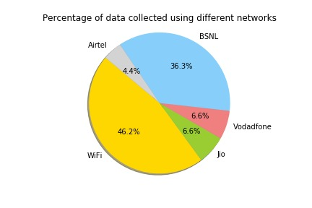
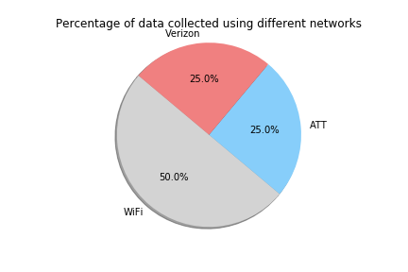
Data Collection
India
USA

Slide 5
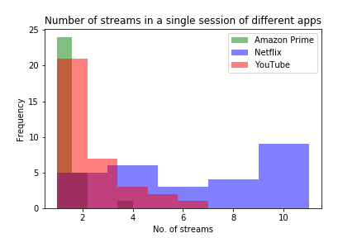
HTTP Protocols
Transport Layer Protocols:
Conclusion:
Amazon Prime – HTTP/2
Netflix – HTTP/1.1
YouTube – QUIC
Applications | Protocol
Amazon Prime | TCP
Netflix | TCP
YouTube | UDP
Comparison of number of streams

Slide 6



YouTube uses QUIC
+
2014
+
+
30% fewer rebuffering

Slide 7
HTTP/2 DoS flaws identified by Netflix
Eight of those weaknesses are:
In the HTTP/2 version, repeated ping requests in Ping flooding may force the server to queue up responses, fall behind and even stop responding.
reset flood
settings flood
empty frames attack
data dribble attack
resource loop attack
zero-length headers
internal data buffering attack

Slide 8
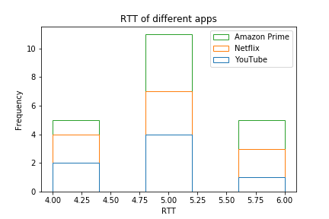
RTT Comparison
RTT of YouTube, Netflix, Amazon Prime are all between 4.00 and 6.00 ms.

Slide 9
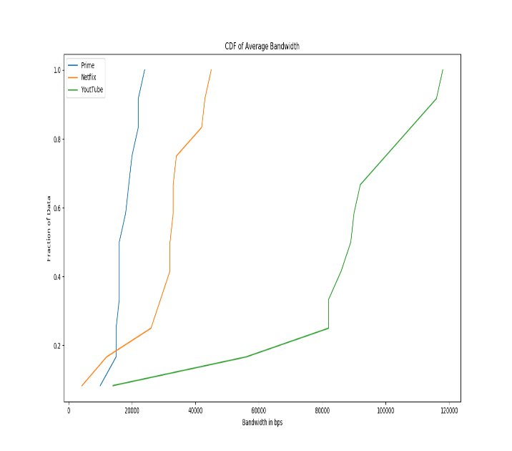
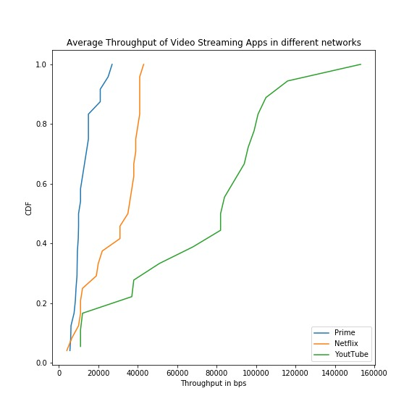
Throughput comparison – India VS USA
India
USA
Average throughput of different video apps across different networks – India and the US.

Slide 10
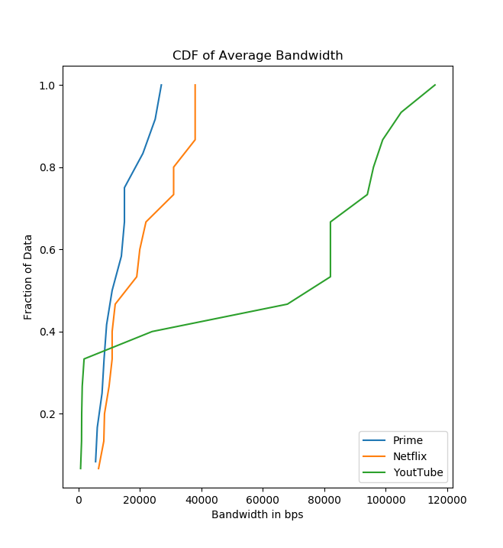
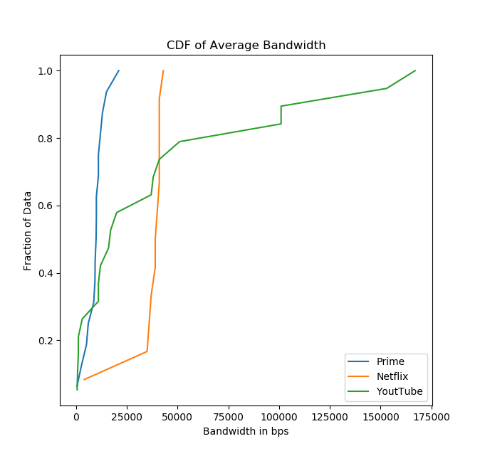
Throughput – Wi-Fi VS mobile networks in India
Average throughput of different video apps across (a) Wi-Fi and (b) mobile networks.

Slide 11
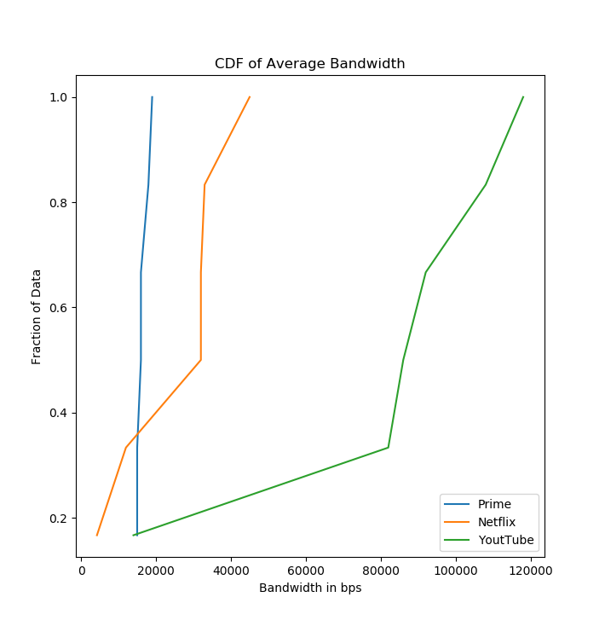
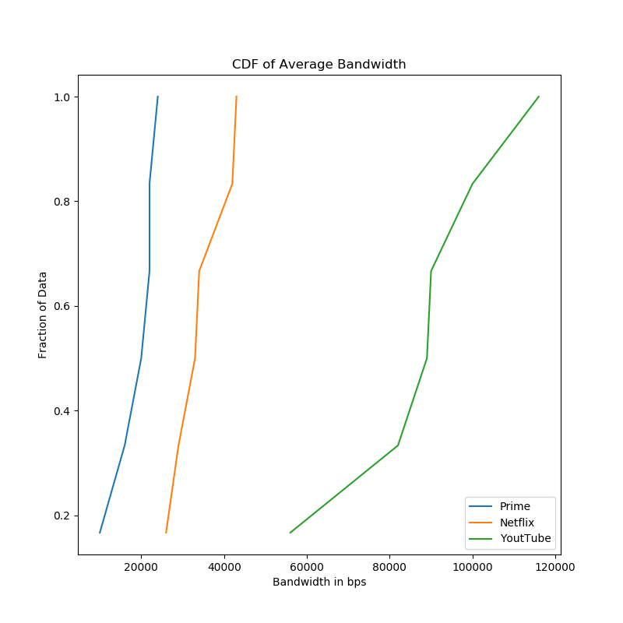
Throughput – Wi-Fi VS mobile networks in USA
Average throughput of different video apps across (a) Wi-Fi and (b) mobile networks.

Slide 12
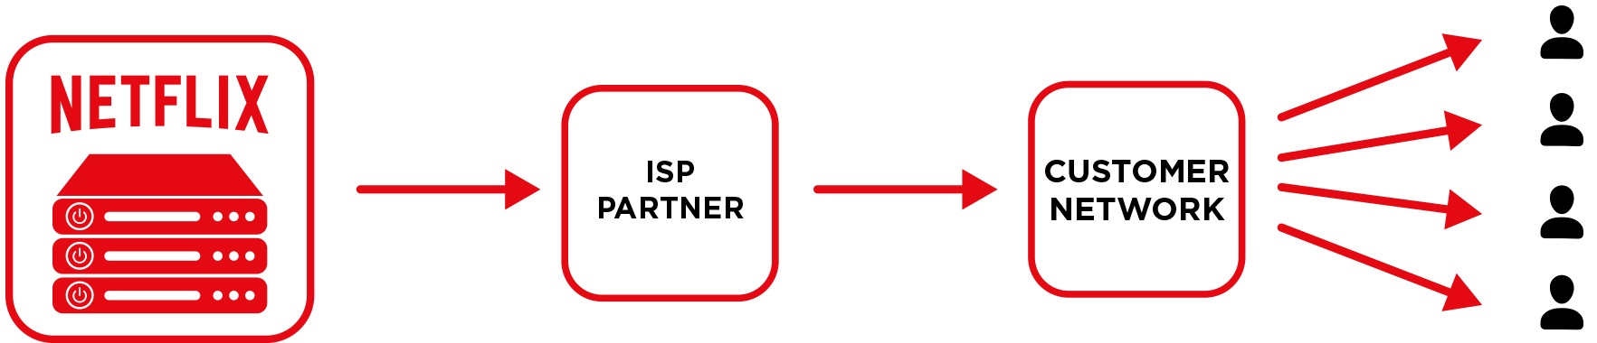
NETFLIX’s Open Connect
90GBps
13,000 people
280 TB of video data each (almost the entire NETFLIX library)
Addresses:
single point of failures,
latency issues in locations away from the origin servers.

Slide 13
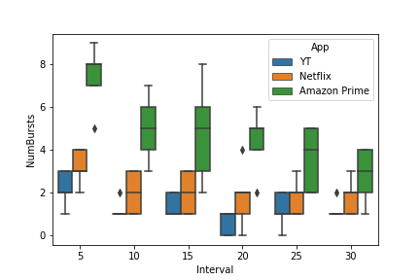
Burst Analysis: Frequency of bursts
Number of bursts/5 sec in Amazon Prime is much higher while YouTube has the least number of bursts.

Slide 14
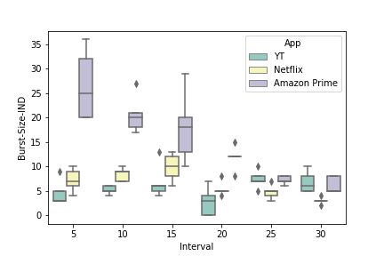
Burst Analysis: Burst Size
The burst size (no of packets) with time, while video streaming is the highest for Amazon Prime.

Slide 15
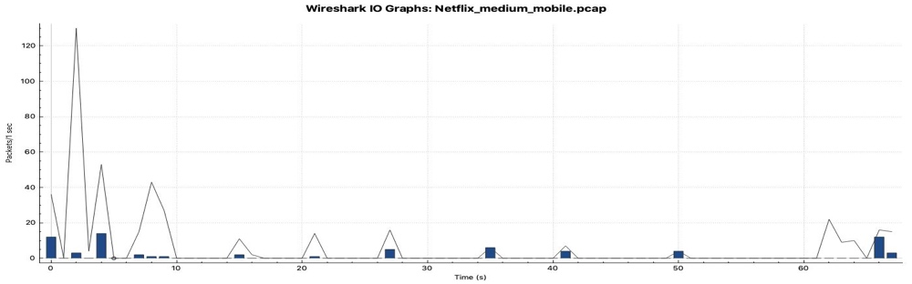
More bursts leads to heavy loss in network

Slide 16
Future Work
How the app behaviors change with different combinations of browsers, devices.
Are Amazon Prime/YouTube affected by HTTP/2 DoS flaws identified by Netflix?
What are the encoding techniques used by the different streaming services?

Slide 17
References
Rao, Ashwin, Arnaud Legout, Yeon-sup Lim, Don Towsley, Chadi Barakat, and Walid Dabbous. "Network characteristics of video streaming traffic." In Proceedings of the Seventh COnference on emerging Networking EXperiments and Technologies, p. 25. ACM, 2011.
Mangla, Tarun, Emir Halepovic, Mostafa Ammar, and Ellen Zegura. "eMIMIC: estimating http-based video QoE metrics from encrypted network traffic." In 2018 Network Traffic Measurement and Analysis Conference (TMA), pp. 1-8. IEEE, 2018.
Ravattu, Radha, and Prudhviraj Balasetty. "Characterization of YouTube Video Streaming Traffic." (2013).
https://nakedsecurity.sophos.com/2019/08/19/netflix-finds-multiple-http2-dos-flaws/
https://ma.ttias.be/googles-quic-protocol-moving-web-tcp-udp/

Slide 18
Thank You!

